Slide 1
OPAY FINANCIAL REPORT 2024
OGBUROGHO BLESSING

Slide 2
INTRODUCTION TO BUSINESS PROBLEM
Opay, as a growing fintech company, seeks to assess its financial health and identify opportunities for growth and cost optimization in 2024
Key points:
Decline in Revenue: Revenue decreased significantly in the last quarter, signaling potential sales or customer retention issues.(replace with problem)
High HR Expense: Despite the revenue drop, HR costs remain high, particularly in salaries, putting pressure on financial stability.
Decline in Profitability: Opay is currently operating at a loss, with increasing expenses and stagnating revenue, indicating a need for strategic changes.

Slide 3
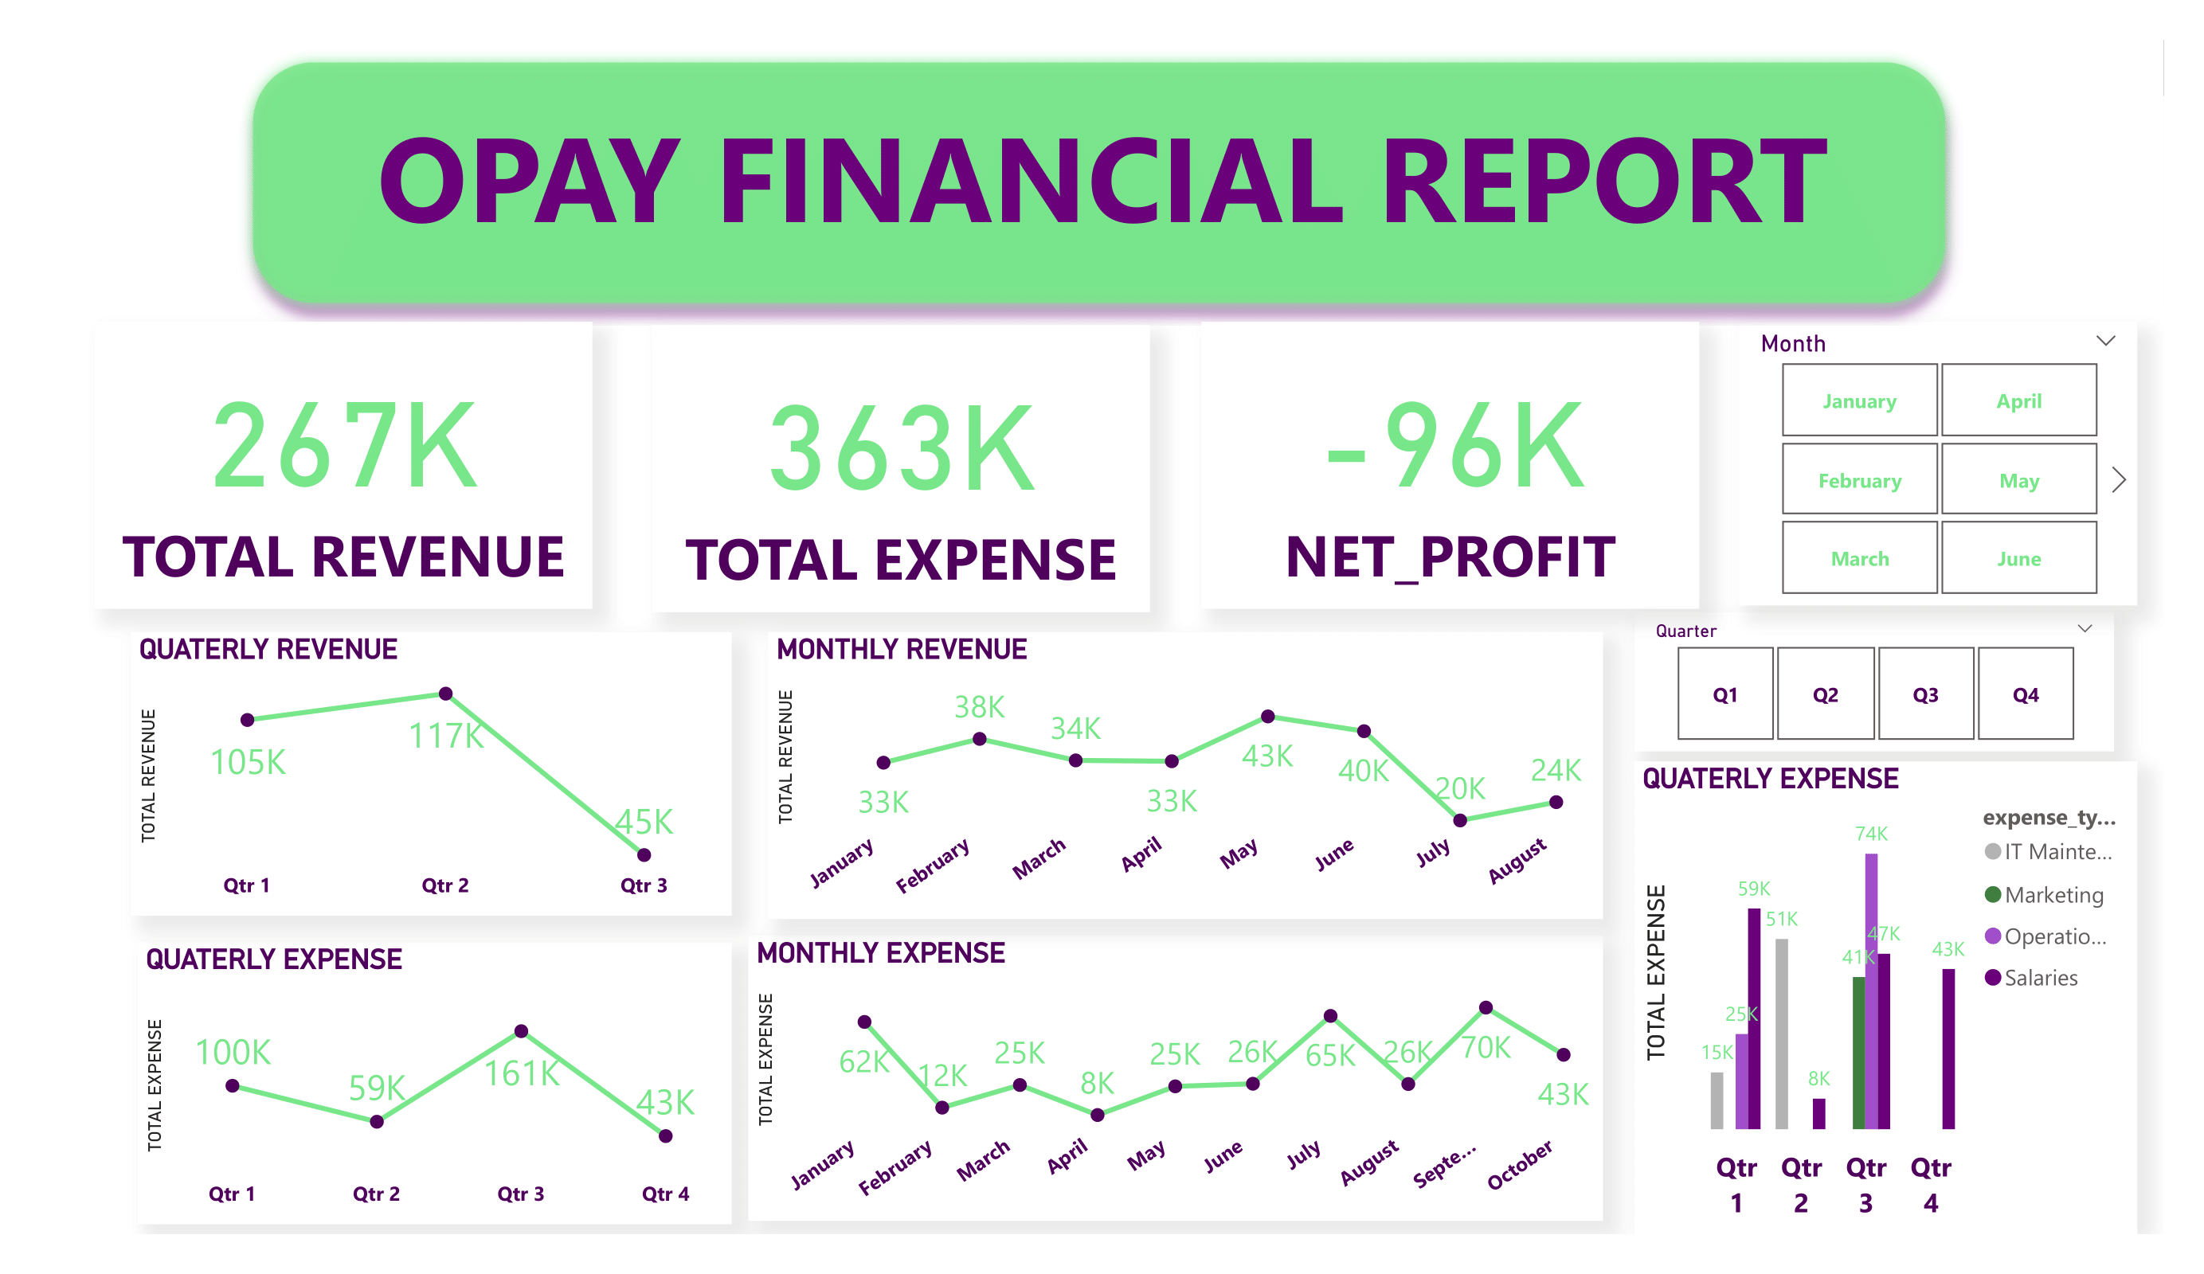
OVERVIEW
Decline in Profitability: Opay recorded a net loss of $96K for the year, driven by high operational expenses and reduced revenue in the last quarter.
Decline in Revenue: There was a significant drop in revenue during the year, with the last quarter generating only $45,000 and no additional income recorded thereafter
High HR Expense: There was a notable increase in expenses during the year, driven primarily by higher costs in operational handling and salaries. This rise in expenditure has significantly impacted the company's profitability.

Slide 4
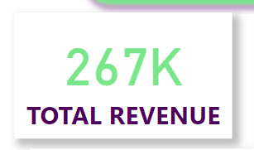
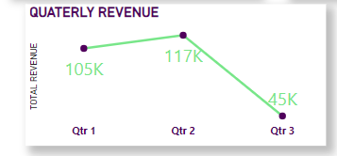
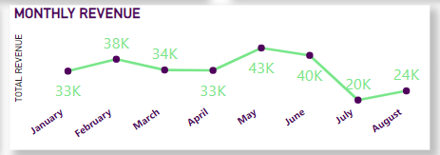
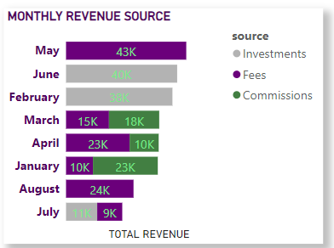
DECLINE IN REVENUE
General Revenue Trend: Opay generated a total of $267,000 in the last 8 months. with May having generated the highest income of $43,000 accounting for 16.27% of overall income and the second quarter generating the highest income of $117K with a massive decline in the 3rd quarter and no additional income recorded in the last quarter.
Monthly Revenue Trend: At 43411, May had the highest Total Revenue and was 113.84% higher than July, which had the lowest Total Revenue at 20301.﻿ ﻿﻿ May accounted for 16.27% of Total Revenue.﻿﻿ ﻿Across all 8 Month, Total Revenue ranged from 20301 to 43411. The bulk of income were generated from fees. With the highest income-generating month acquiring money from only this sector and fees generating income for 6 out of 8 months showing it’s high potential for profitability
Quarterly Revenue Trend: At $117k Qt2 accounted for 43.84% of total revenue. Although an initial rise in first quarter there was a massive downward trend in the 3rd quarter of the year with a significant difference of 161.91% in decline and no additional income recorded in the last quarter . This indicates that people perform less transactions involving commissions towards year end.

Slide 5
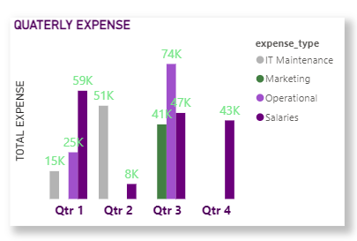
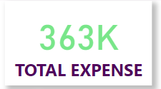
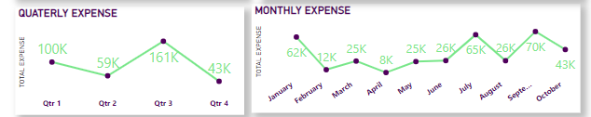
HIGH HR EXPENSE
General Expense Trend: Opay spent a total of $363,000 in the last 10 months. with September having had the highest expense of $43,000 accounting for 19.3% of overall expense and the third quarter generating the highest expense of $161K primarily in areas of operations and salaries
Monthly Expense Trend: At 70058, September had the highest Total Expense and was 757.19% higher than April, which had the lowest Total Expense at 8173..﻿ ﻿﻿ September accounted for 19.30% of Total Expense ..﻿﻿ ﻿﻿Across all 10 Month, Total Expense ranged from 8173 to 70058. The trend shows more expenses at the beginning and end of the year season.
Quarterly Expense Trend: At $161k Qt2 accounted for 44.45% of total expense primarily in areas of operations and salaries. . The overall trend shows bimodal expense peak. Marketing was carried out only within that quarter which added to the expense. Despite revenue not being generated in the q4 salaries were still paid which was inevitable. This accounted for 15.3% of overall expense.

Slide 6
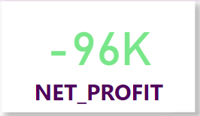
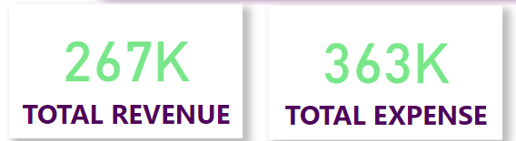
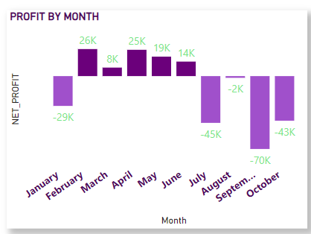
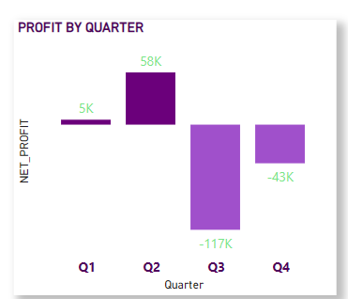
DECLINE IN PROFITABILITY
General Profit Trend: While Opay generated a total of $267,000 in the last 10 months the company spent a total of $363,000 in the last 10 months Leading to an overall -$96k deficit in profit.
Monthly Profit Trend: At the end of the first month of the year Opay had ran into a loss of -$29k there was however an increase in profit from february to June with profit ranging from $8-29k and February accounting for the highest profit made of $29k but noticed a continuous decline in profit afterwards which accounted for 56% decline in profit. Opay has acquired an overall 33% in profit and 67% in loss..
Quarterly Expense Trend: The first and second quarters of the year experienced an increase in profit with a total of $63k and a decline after wards with a total of -$160k with a high contributory factor coming from the expense in operations in the third quarter and salary payment in the 4th quarter after having made little to no profit.

Slide 7
GOALS AND ACTIONS
Goals
Increase in Revenue
Decrease in Expense
Increase in Profit
Actions
Increase in Revenue: Since most transactions are performed via fees I’d suggest an increase in how much fee is charged per transaction.
Decrease in Expense: Acknowledging that expense on salaries cannot be cut off. Reduce expense on any aspect by assessing the available income before spending.
Increase in Profit: Focus on increasing Revenue and reducing expense to make better profit.

